Slide 1


Implementing Extractive and Abstractive Text Summarization Techniques to Enhance Student Comprehension
Team Members:
Shivam Jayeshkumar Mehta (sjmehta@uwm.edu)
Atharva Pradeep Vaishnav (vaishna2@uwm.edu)
Venkata Kailash Tanniru (vtanniru@uwm.edu)
Semester: Fall 2024
Instructor: Dr. Susan Mcroy

Slide 2
Introduction
Our initial studies for the text classification domain presented us with two conflicting literature, one mentioning the factual accuracy of Text rank, which is an Extractive summarization suitable for learning summaries, and another claiming the same for Transformer– T5, abstractive summarization to be suitable because of its coherent and fluent summaries.
So, our project aims to implement and compare the two text summarization techniques and determine which method might produce better summaries for our use case.

Slide 3
Motivation
College students deal with a lot of reading material, which can be overwhelming. We aim to implement the summarization techniques to help students by making this information shorter, easier to understand, and faster to sort through. But which one to pick?
Text Rank picks meaningful sentences directly from the text to create quick and accurate summaries.
T5 summarization rewrites the content more simply, making it easier to read. Using both methods helps students learn faster, understand better, and find important information quickly.

Slide 4
DATA PREPARATION
This was the most labor-intensive step, as finding a comprehensive dataset with learning learning-focused summary was proving a challenging task. Which led us to make a data set of our own.
We utilized the CCDV Arxiv Summarization Dataset from Kaggle as a Base to procure the data of scientific articles and created our summaries based on its abstract and article details
Another challenge occurred in the data cleaning step, where every unique data field is large and contains scientific data with partial instances of latex formatting and other nuanced things and references.

Slide 5
Extractive Summarization – Text Rank
Text Rank is a graph-based unsupervised algorithm based on the PageRank algorithm.
It identifies key sentences from a document by computing their importance based on a similarity graph.
Advantages of Text Rank:
Factual Accuracy: Since it extracts sentences from the original text, it maintains the exact wording and factual information.
No Training Needed: Works well without any labeled data or model training, making it computationally efficient.
Domain Agnostic: Can be applied to different types of text without any domain-specific optimizations (scientific, news, educational).

Slide 6
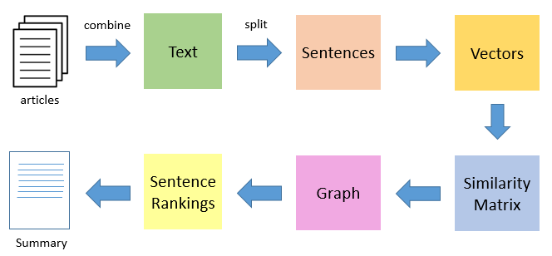
Extractive Summarization – Text Rank
Working:
Tokenization: Separate text into sentences
Vectorization: Normalize each word with TF-IDF
Similarity matrix: using cosine similarity matrix between pairs of sentences
Graph Construction: represent the sentences as nodes and similarities as edges
Page rank: ranking sentences based on their importance in the graph
Summarization: using top-ranked sentences.

Slide 7
TEXT - RANK OUTPUTS
ORIGINAL SUMMARY:
A new barrier penetration formula, derived from the WKB approximation, accounts for the long-range Coulomb interaction, making it effective for low-energy penetrations below the Coulomb barrier. The formula provides accurate penetrability calculations and closely matches WKB results. Applied to alpha-decay half-life evaluations for atomic nuclei, it demonstrates excellent agreement with experimental data, particularly for spherical nuclei. This formula enhances the study of barrier penetrability in nuclear processes and fusion reactions.
GENERATED SUMMARY: in the present work , we derived a new barrier penetration based on the wkb approximation . in the study of barrier penetration in nuclear physics , the parabolic approximation is usually adopted because an analytical solution exists for the penetrability of a parabola barrier potential . in the present work , we derived a new barrier penetration , eq . therefore , the new could be used in the study of barrier penetration at energies much smaller than the barrier height .

Slide 8

Abstractive Summarization - T5 Transformer Model
T5 (Text-to-Text Transfer Transformer) is a Transformer-based model introduced by Google.
It generates new sentences that capture the meaning of the original text, rather than copying sentences directly.
Advantages of T5 include,
Fluent and Coherent Summaries: Produces summaries that are paraphrased, fluent, and closer to human-written text.
Handles Complex Text: Effective for summarizing long, complex documents by rephrasing ideas clearly.
Adaptability: Can be fine-tuned for specific tasks or domains, improving performance for targeted applications.
Context Awareness: It understands context across the entire input.

Slide 9
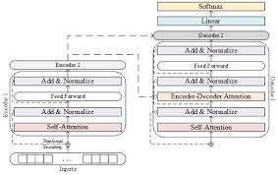
Abstractive Summarization - T5 Transformer Model
Key Components of T5
Encoder-Decoder Architecture: Encodes the input and decodes the output iteratively.
Self-Attention: This allows the model to consider all parts of the input when generating each word.
Positional Encoding: Adds positional information to tokens since Transformers don’t inherently process sequence order.

Slide 10
T5 Transformer Model - OUTPUTS
ORIGINAL SUMMARY:
A new barrier penetration formula, derived from the WKB approximation, accounts for the long-range Coulomb interaction, making it effective for low-energy penetrations below the Coulomb barrier. The formula provides accurate penetrability calculations and closely matches WKB results. Applied to alpha-decay half-life evaluations for atomic nuclei, it demonstrates excellent agreement with experimental data, particularly for spherical nuclei. This formula enhances the study of barrier penetrability in nuclear processes and fusion reactions.
GENERATED SUMMARY: quantum tunneling is a common quantum phenomenon . it governs many other nuclear processes such as fission and fusion . the tunneling effect is also widely adopted today in the study of heavy ion reactions . the parabolic approximation works remarkably well both for the penetrability and for the fusion cross section .

Slide 11

QUANTITATIVE EVALUATION
ROUGE-1:
It measures the overlap of individual words (unigrams) between the generated summary and the reference summary.
It helps ensure that the main ideas and key terms are included in the summary, which is crucial for factual accuracy in educational materials.
ROUGE-2:
It measures the overlap of word pairs (bigrams) between the generated summary and the reference summary. Evaluating the preservation of context and phrase-level information.
It provides a more in-depth assessment compared to ROUGE-1 by considering the relationship between adjacent words.

Slide 12
QUANTITATIVE EVALUATION
Flesch-Kincaid Grade Level:
It is a readability metric that calculates the grade level required to understand a given text.
Helps avoid overly complex or simplistic summaries, ensuring that students can easily understand the content.
BERTScore:
BERTScore uses contextual embeddings (from the BERT model) to compare the semantic similarity between generated and reference summaries.
it captures semantic nuances, ensuring that the summary conveys the correct message even when different words are used

Slide 13
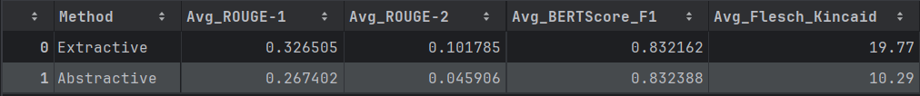
QUANTITATIVE EVALUATION RESULTS
Extractive Summarization:
ROUGE Scores are higher compared to abstractive summarization, indicating better overlap with the reference summaries.
BERTScore is slightly higher, meaning the semantic similarity is well-preserved.
Flesch-Kincaid Grade is higher, indicating the summary is more complex and harder to read near graduate level.
Abstractive Summarization:
Slightly lower ROUGE Scores and BERTScore, which is expected since abstractive summaries paraphrase content.
Flesch-Kincaid Grade is lower, making it more readable and suitable for students with readability at the high school level.

Slide 14
QUALITATIVE EVALUATION
Learning is subjective, and everyone has different methods. Not only will everyone have different preferences for summary types, but even for a single person, the preference will vary depending on the subject domain.
Thus, we are also implementing a comprehensive comparison study by doing a human evaluation to determine which type of summarization is more preferred in general.

Slide 15
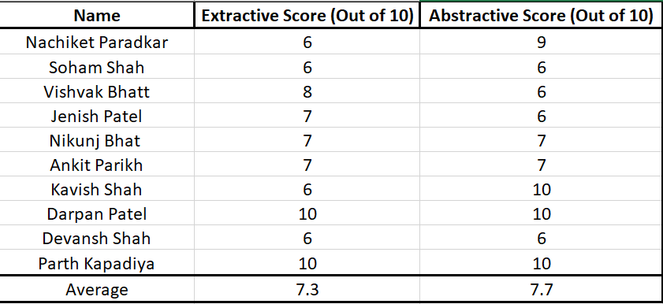
QUALITATIVE EVALUATION RESULTS

Slide 16
Applications
Educational Tools: Automated summarization tools for students to quickly grasp key concepts from academic texts.
Research Assistance: Helps summarize long research articles, saving time during literature reviews.
Content Aggregation Platforms: Websites or applications providing concise summaries of news articles or scientific papers.
Online Learning Platforms: Summaries of video transcripts, lecture notes, and e-learning content to improve accessibility and learning efficiency.

Slide 17
Tools and Technologies Used
Programming Language: Python
Libraries and Frameworks:
NLTK, spaCy: Text preprocessing
TensorFlow, PyTorch: Model development
Hugging Face Transformers: T5 implementation
NetworkX: graph construction and page rank
ROUGE (rouge-score), TextStat, BERTScore: Evaluation metrics
Dataset Handling:
Pandas, NumPy: Data cleaning and manipulation
Dataset Source: Custom-built dataset using CCDV ArXiv Summarization Dataset as the source

Slide 18
Conclusion
TextRank (Extractive): Preserves factual accuracy and original wording, making it suitable for precise information retrieval, but too complex for understanding the topic.
T5 (Abstractive): Generates fluent, paraphrased summaries, which can improve comprehension and readability, making the summary more manageable to understand.
Each method has its pros and cons, but depending on the use case, if college students need to search through large amounts of documents, then the extractive is much more suitable. In contrast, if a college student needs to understand what the article is trying to convey, abstractive techniques are much more suitable.

Slide 19
CONTRIBUTIONS
Shivam Jayeshkumar Mehta :
Dataset Creation and Data cleaning.
Extractive Summarization Implementation
Atharva Pradeep Vaishnav:
Dataset Creation and Data cleaning.
Abstractive Summarization Implementation.
Venkata Kailash Tanniru:
Dataset Creation and Data cleaning.
Evaluation Metrics Implementation and comprehensive evaluation

Slide 20
THANK YOU

